Slide 1



Sparsh –Online Store
IACSD Akurdi,Pune
PG-DAC
Project Group No. 73
Gaikwad Suraj Mahadev (230341220065)
Rohit Kumar (230341220147)
Supervisor :Mrs. Manjiri Deshpande
Center for Development of Advanced Computing

Slide 2

IACSD,PUNE
INTRODUCTION
MOTIVATION
OBJECTIVE
TECHNOLOGY USED
UML DIAGRAM
SCREENSHOTS
S/W AND H/W REQUIREMENTS
FUTURE SCOPE
CONCLUSION
REFERENCES

Slide 3
IACSD,PUNE
INTRODUCTION
In the age of digital transformation, where convenience and accessibility are paramount, the sparsh Online Plant In the age of digital transformation, where convenience and accessibility are paramount, the Sparsh Online Plant Store application emerges as a solution tailored to meet the growing demands of plant enthusiasts. This project report serves as an introductory guide to the development and specifications of the Sparsh application, an online platform that facilitates the seamless purchase of plants. Purpose: The primary objective of this document is to present a comprehensive overview of the Sparsh Online Plant Store application. By delineating its purpose, scope, objectives, and requirements, this report sets the stage for understanding the intricacies of a modern e-commerce platform designed to redefine the plant shopping experience.

Slide 4
IACSD,PUNE
MOTIVATION
As we know that searching for fresh Plants is so tedious job, so this website is developed to providing the simple and good searching and delivery option.
With the help of this app customer can search for different Plants as per there liking and get the lot of options easily available to them.
And by this website the sellers can sell their products at best possible pricing.

Slide 5
IACSD,PUNE
OBJECTIVE
The objective of this project report is to provide a comprehensive overview of the development, specifications, and functionalities of the Sparsh Online Plant Store application. This report aims to clearly outline the purpose, scope, requirements, and features of the application, shedding light on its significance, user benefits, and technological aspects. By achieving this objective, the report seeks to facilitate a deeper understanding of Sparsh as a modern e-commerce platform dedicated to simplifying the process of purchasing plants online.

Slide 6
IACSD,PUNE
TECHNOLOGY USED
Front End : For front end ReactJS has been used.
Back End : For back end Spring Boot has been used.
Back End Database : For back end database MySQL has been used.

Slide 7
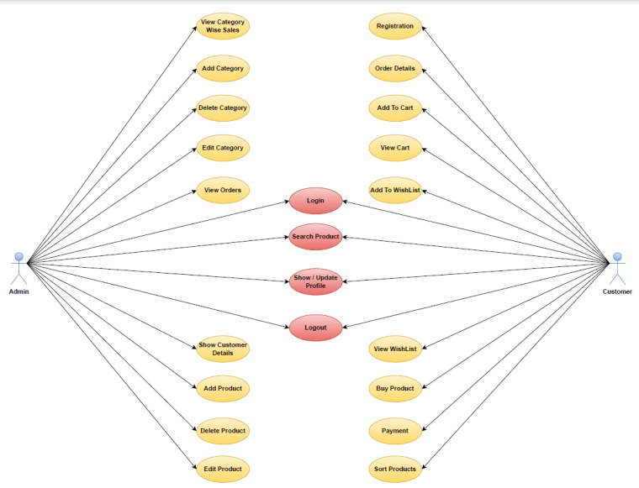
IACSD,PUNE
UML DIAGRAM
Admin+Customer

Slide 8
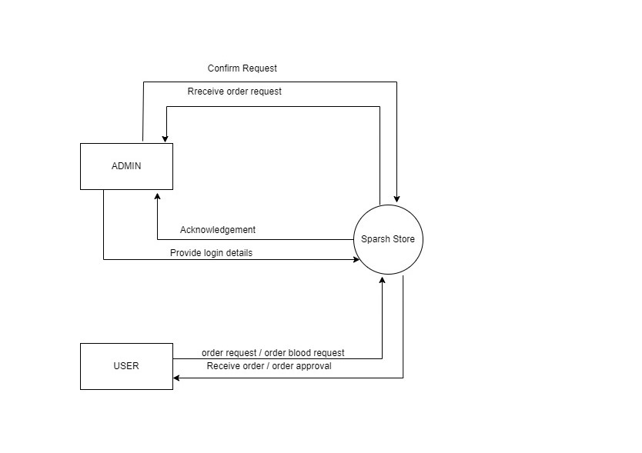
IACSD,PUNE
Zero level DFD

Slide 9

IACSD,PUNE
SCREENSHOTS
Home Page

Slide 10
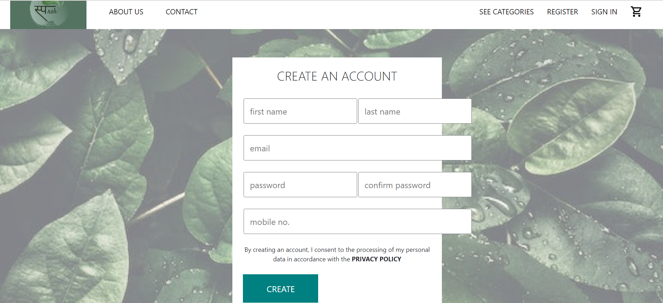
ss
IACSD,PUNE
SCREENSHOTS
Sign Up Page

Slide 11
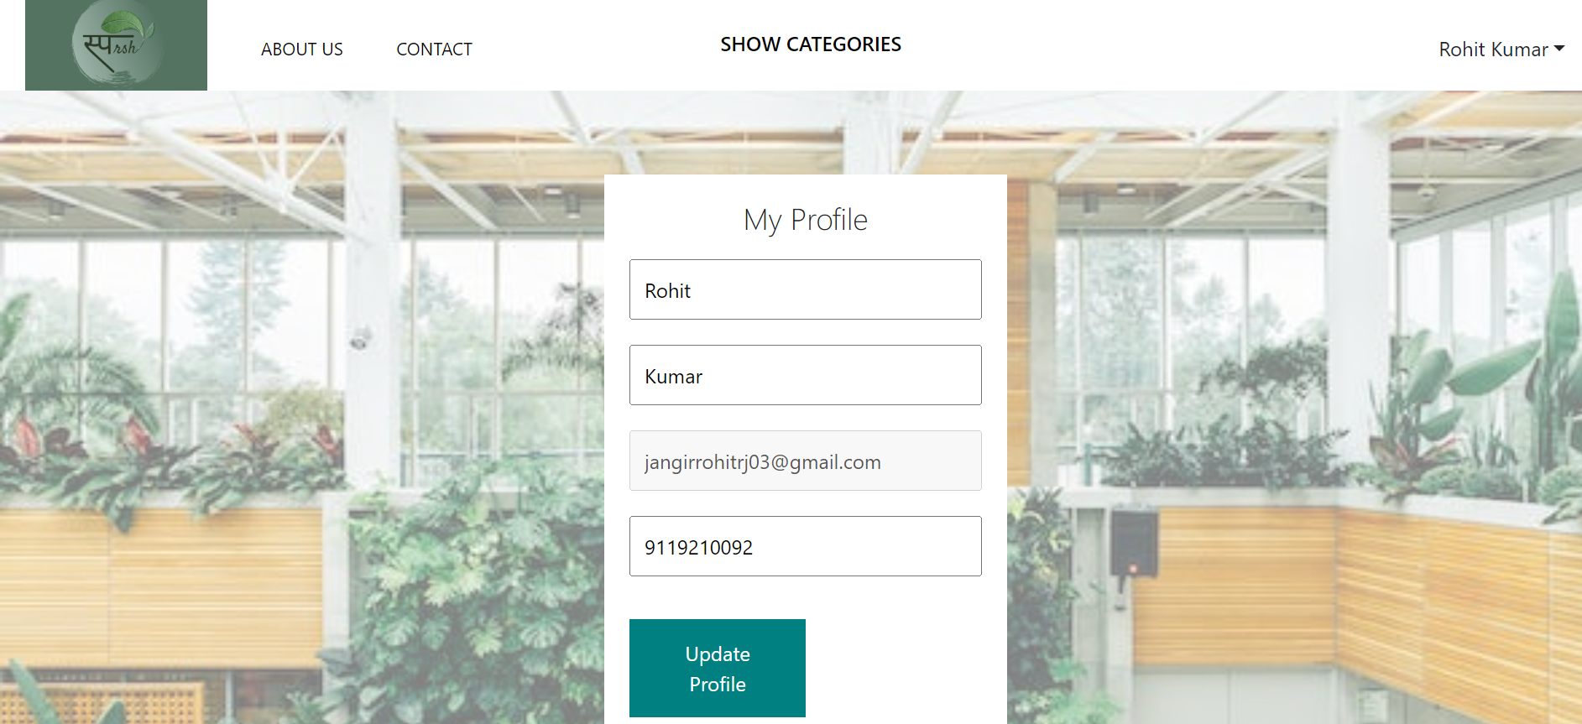
IACSD,PUNE
SCREENSHOTS
Login Page

Slide 12
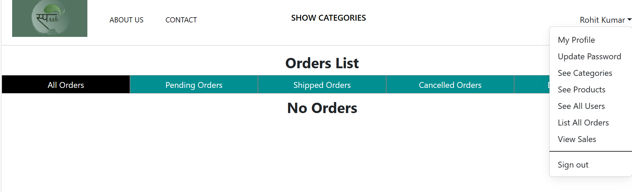
IACSD,PUNE
SCREENSHOTS
Product

Slide 13
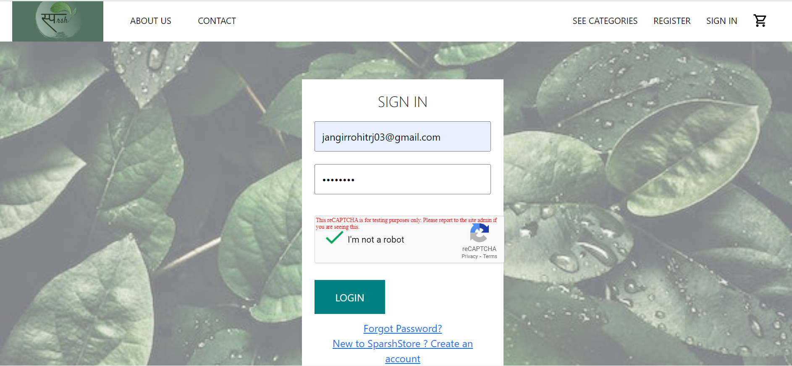
IACSD,PUNE
SCREENSHOTS
Admin Page

Slide 14
IACSD,PUNE
SCREENSHOTS
User Profile

Slide 15
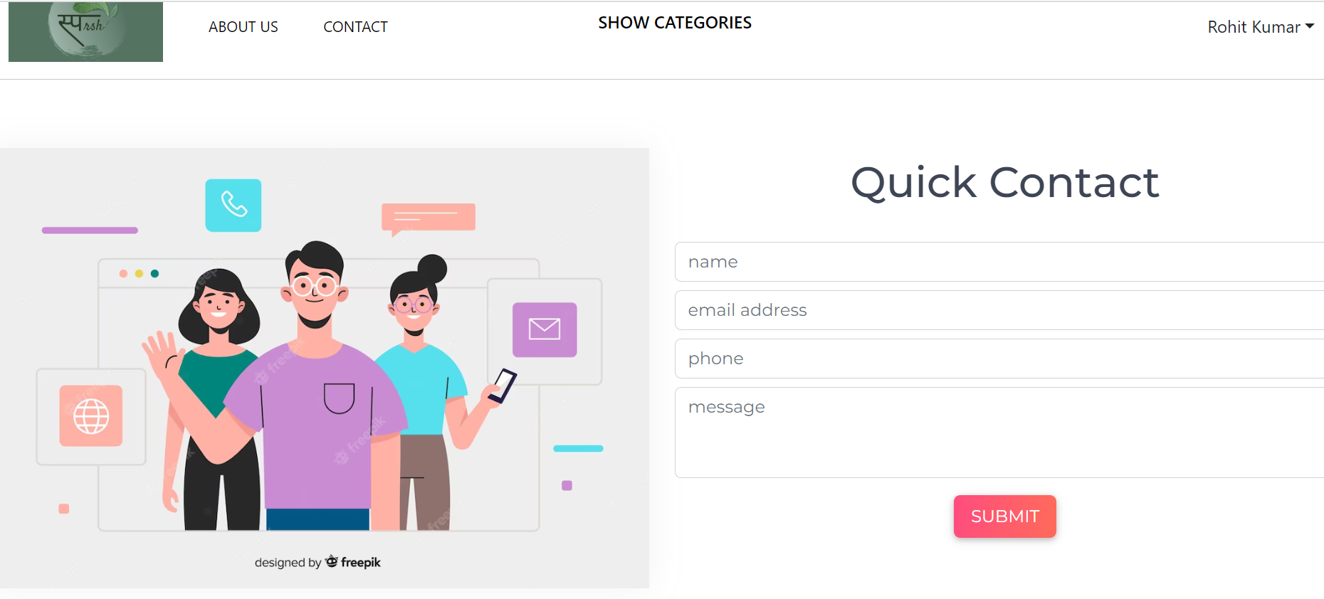
IACSD,PUNE
SCREENSHOTS
Check Out

Slide 16
IACSD,PUNE
S/W AND H/W REQUIREMENTS
SERVER SIDE :-
Processor: Intel® Xeon® processor 3500 series
HDD: Minimum 500GB Disk Space
RAM: Minimum 4GB
OS: Windows 10
Database: MySQL
CLIENT SIDE (minimum requirement) :-
Processor: Intel Dual Core
HDD: Minimum 80GB Disk Space
RAM: Minimum 2GB
OS: Windows 7

Slide 17
IACSD,PUNE
FUTURE SCOPE
The scope of this project report is to provide a comprehensive understanding of the Sparsh Online Plant Store application, outlining its purpose, functionalities, and attributes. By defining the boundaries and extent of the application's capabilities, this report aims to elucidate the project's focus and the value it brings to users.

Slide 18
IACSD,PUNE
CONCLUSION
It has been a great pleasure for us to work on this exciting and challenging project. This project proved good for us as it provided practical knowledge of not only programming in JAVA and JavaScript web based application and no some extent Windows Application and SQL Server, but also about all handling procedure related with Freshop.
It also provides knowledge about the latest technology used in developing web enabled application and client server technology that will be great demand in future. This will provide better opportunities and guidance in future in developing projects independently.

Slide 19
IACSD,PUNE
REFERENCES
[1] JavaScript Enlightenment, Cody Lindley-First Edition, based on JavaScript 1.5, ECMA-262, Edition
[2] Mc Graw Hill’s, Java: The complete reference 7thEdition, Herbert Scheldt
[3] Complete CSS Guide, Maxine Sherrin and John Allsopp-O'ReillyMedia; September 2012
[4] Ali Bahrami, Object-Oriented System Development, Third Edition, Tata McGraw Hill Edition
Bootstrap · the most popular HTML, CSS, and JS library in the world. (getbootstrap.com)

Slide 20



IACSD,PUNE
THANK YOU
PG –DAC/DITISS
Center for Development of Advanced Computing

